Slide 1


Family History
Lesson #6
Indexing

Slide 2

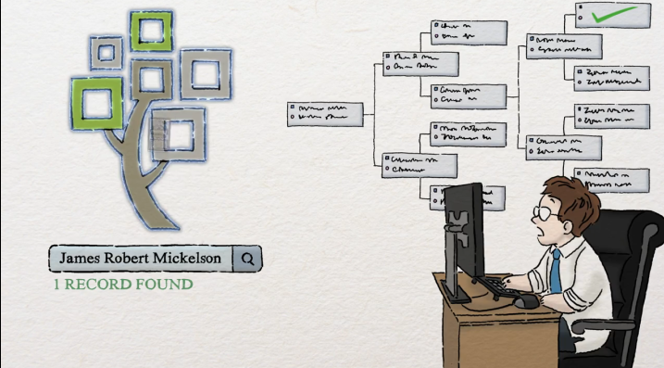
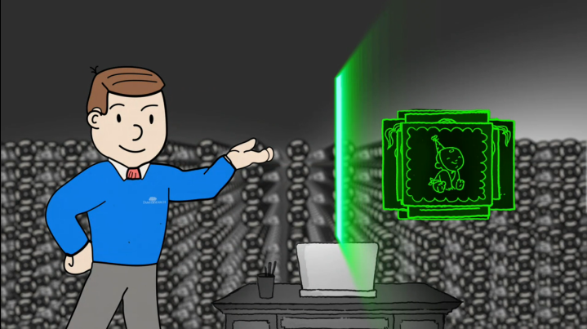
Indexing Overview
Two videos on indexing:
  [2:41] [1:49]

Slide 3
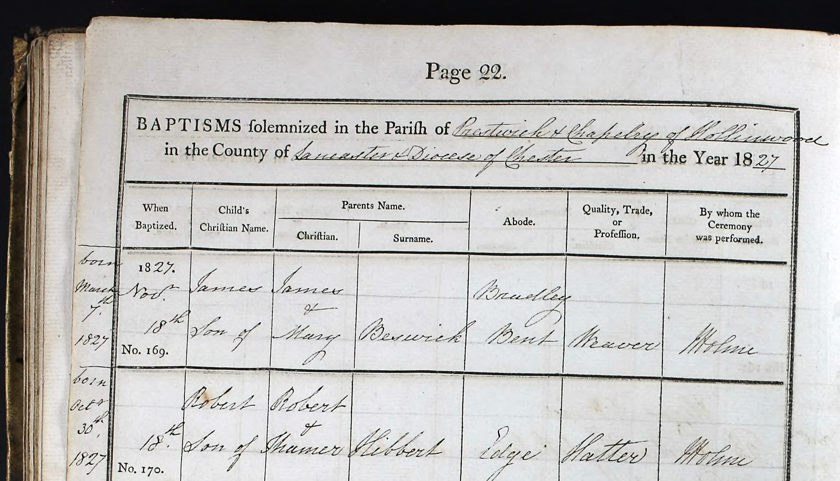
Indexing Overview
Indexing Record Example

Slide 4
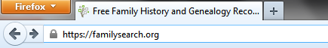
Downloading Indexing Tool
Open Web Browser and go to www.familysearch.org

Slide 5



Slide 6
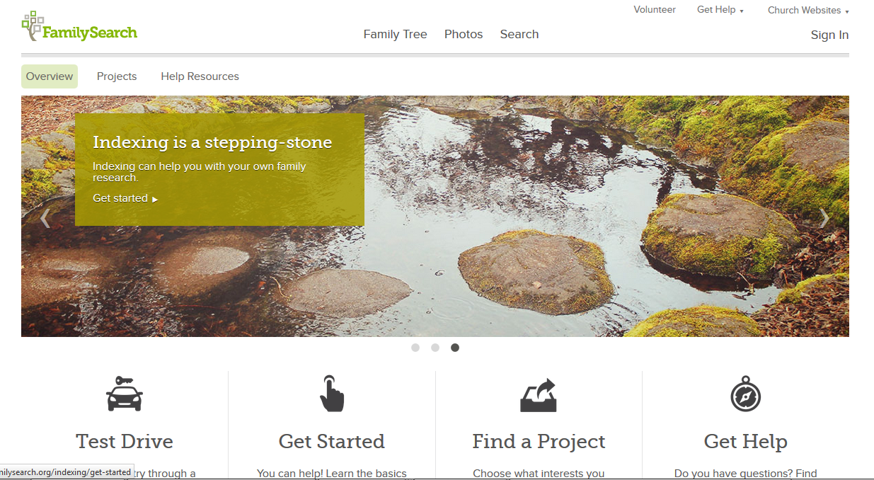

Slide 7
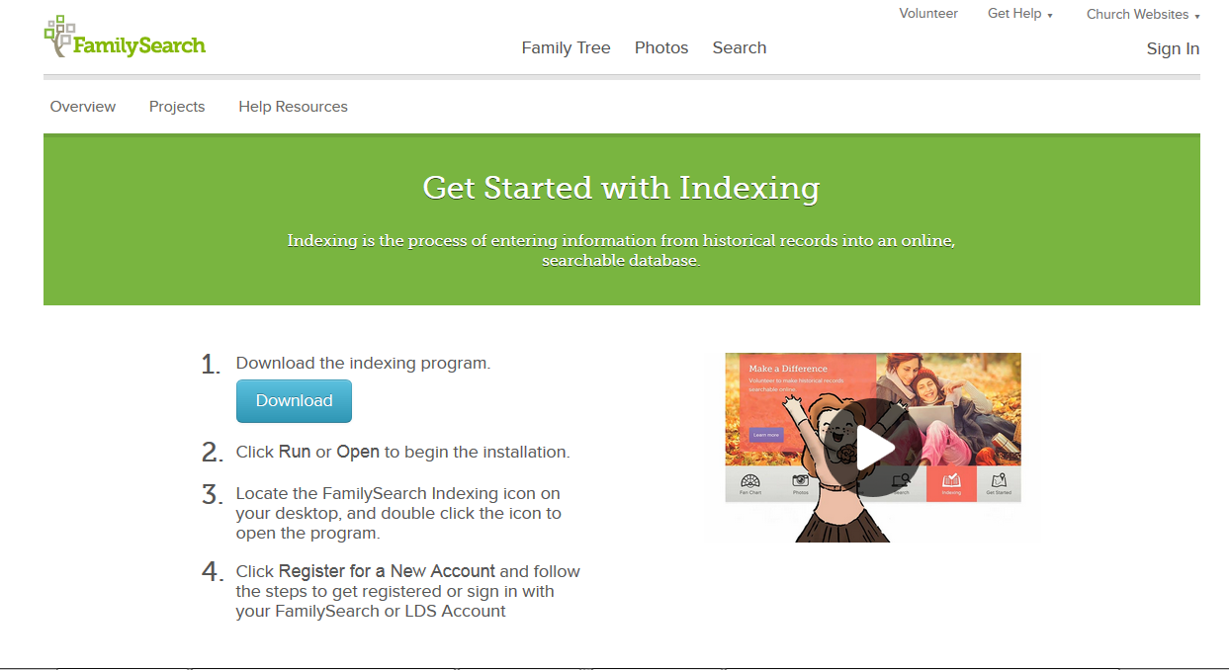

Slide 8
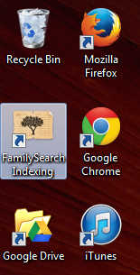
Downloading Indexing Software
When download is complete, You will see the shortcut to the indexing software on your desktop.

Slide 9
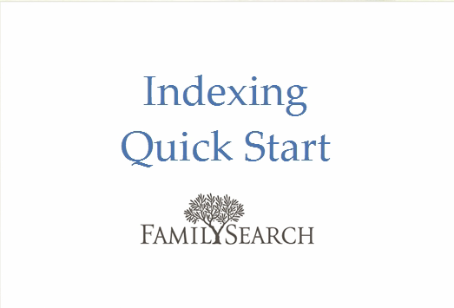
Indexing Software Overview
Indexing Quick Start Video:
  [5:27]

Slide 10
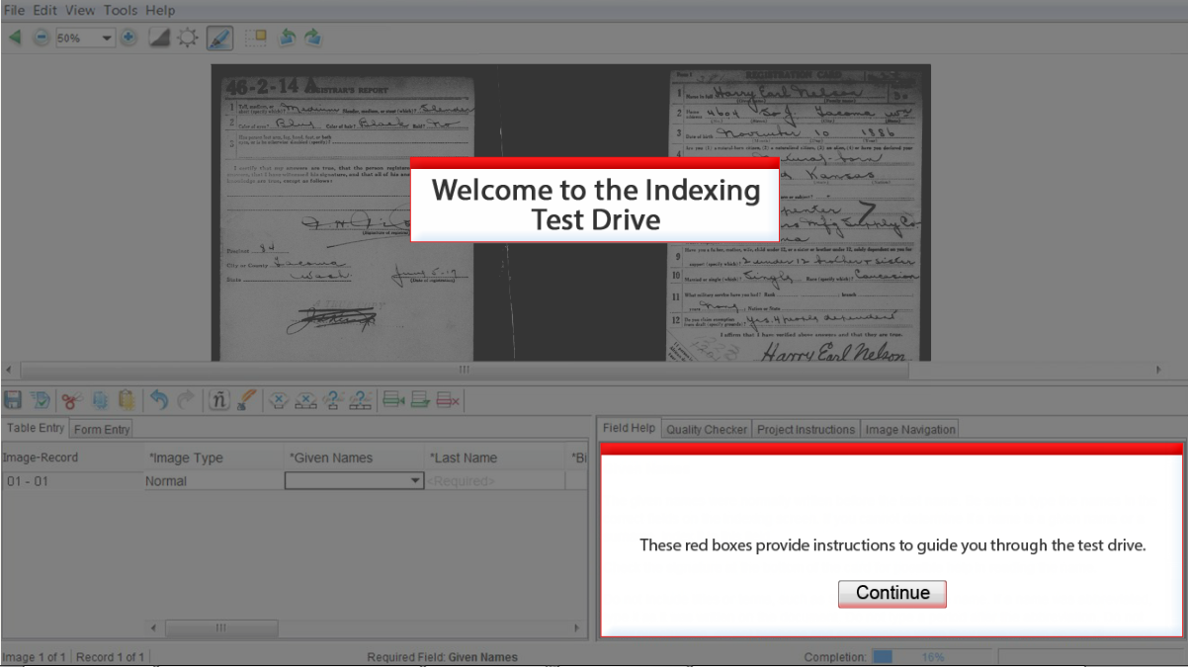
Indexing Test Drive
Online Indexing Test Drive Available. Click Here

Slide 11
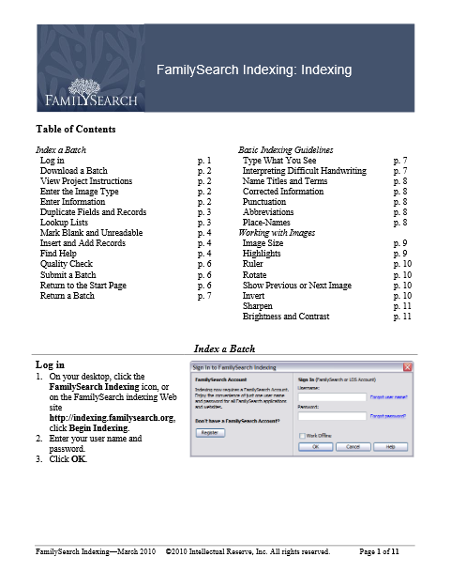
Indexing Handout
Indexing Handout Click Here

Slide 12
Statistics
Indexing Effort World-Wide:
Total Records Completed: 1,074,435,236
Current Projects: 217
Total Records Completed in 2013: 116,063,640
Contributors in 2013: 268,018
Stats reported in the November FamilySearch Indexing newsletter.

Slide 13

Need Help?
Help is always available 24 hours a day.
1-800-406-1830

