Slide 1


Family History
Merge Duplicates, Edit Info,
Establish Relationships
Lesson #3

Slide 2

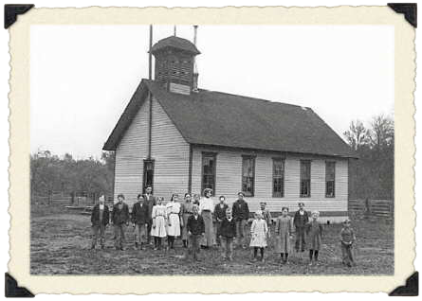
Review Last Week’s Homework
Search for records within FamilySearch.org for several of your ancestors.
Find or scan photos or documents of some of your ancestors.
Upload them to familySearch.org

Slide 3
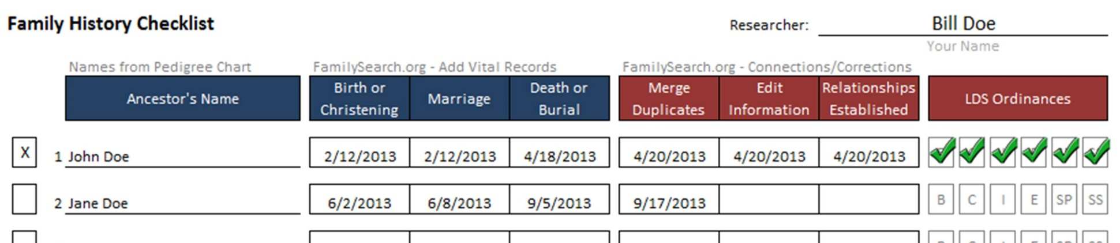
Family History Checklist
In the previous lesson, we covered the first 3 items on the checklist...documentation of Birth/Marriage/Death.

Slide 4
Family History Checklist
Next, we will be covering the next3 items on the checklist...Merge Duplicates, Edit Information, Establish Relationships.

Slide 5
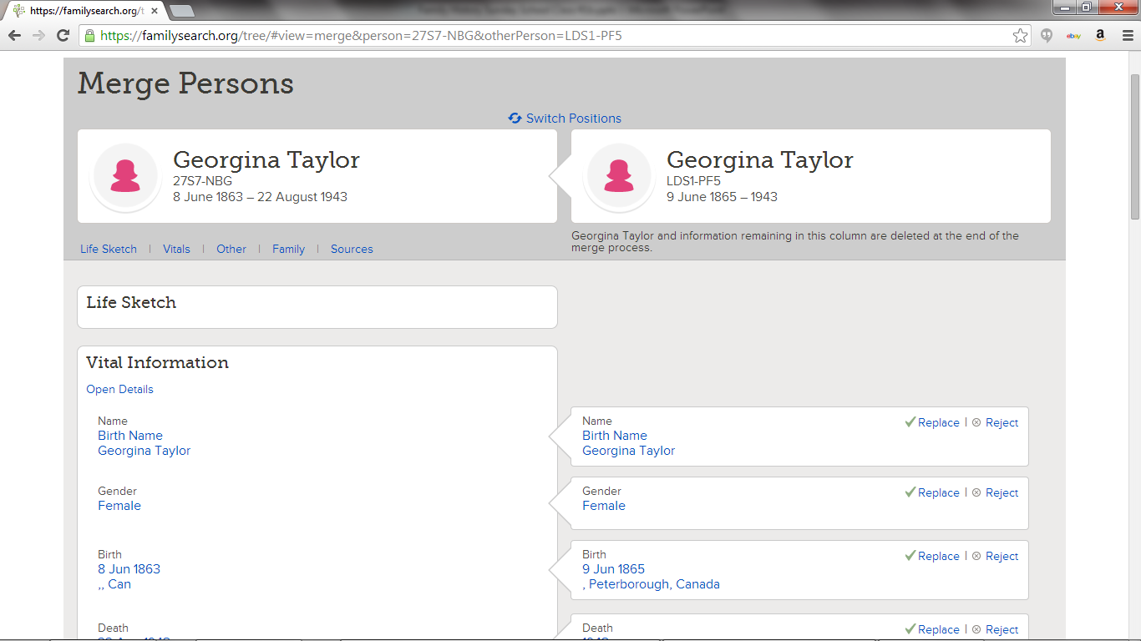
Merging Duplicates

Slide 6
Merging Duplicates
It is not uncommon for multiple records to be created for the same person.
Temple Ordinances can often be done many times for an ancestor because multiple records exist.
Merging duplicate records is an important step to take before printing a Family Ordinance Request (FOR).

Slide 7
Merging Duplicates
It is not uncommon for multiple records to be created for the same person.
Temple Ordinances can often be done many times for an ancestor because multiple records exist.
Merging duplicate records is an important step to take before printing a Family Ordinance Request (FOR).

Slide 8
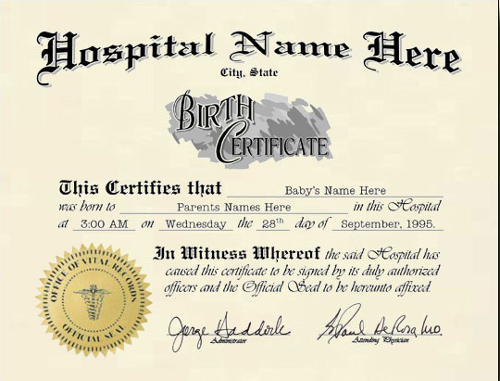
Merging Duplicates
Merging duplicates can be difficult when forced to guess if information is correct. Completing the documentation portion first will greatly simplify this process.

Slide 9
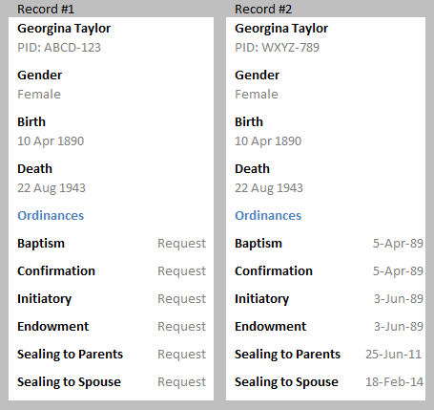
Merging Duplicates
By searching for possible duplicates, you may find another record of the same ancestor that has additional information or ordinance work already completed.

Slide 10
Merging Duplicates
Merging records will combine the two records into one, bringing over what information you want to keep.
All Family Tree connections will be maintained.
A duplicate Temple trip has just been eliminated.

Slide 11
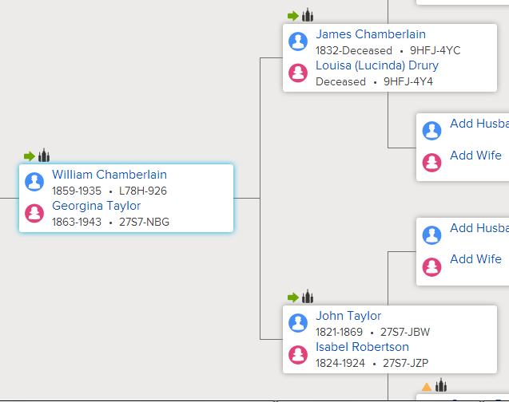

Merging Duplicates
Here is how to search for and merge duplicate records:
In Tree View, click on your ancestor.

Slide 12
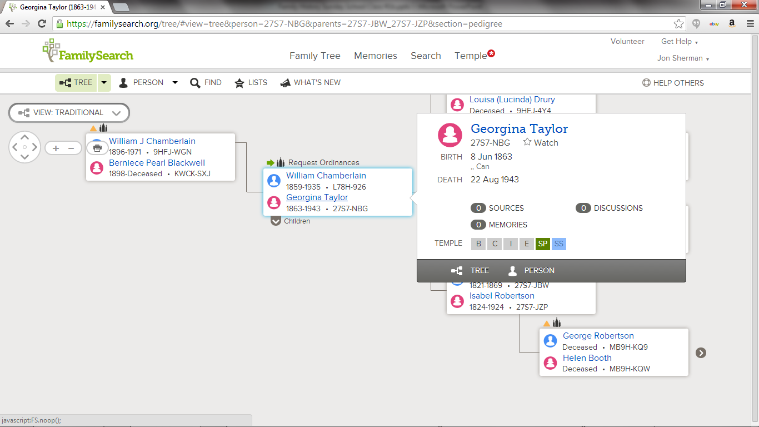
Merging Duplicates
Click on Person view.

Slide 13
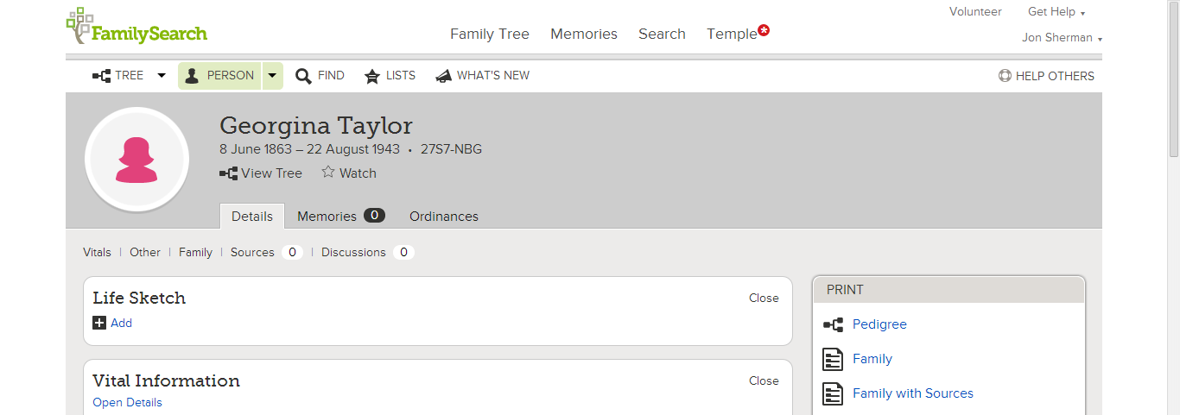
Merging Duplicates
Click on the Details view.

Slide 14
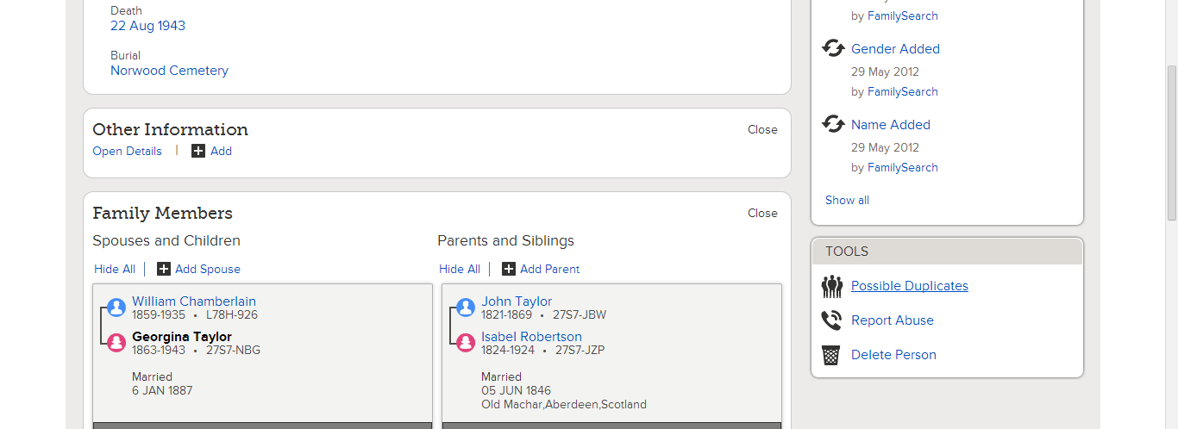
Merging Duplicates
Under Tools, click on Possible Duplicates.

Slide 15
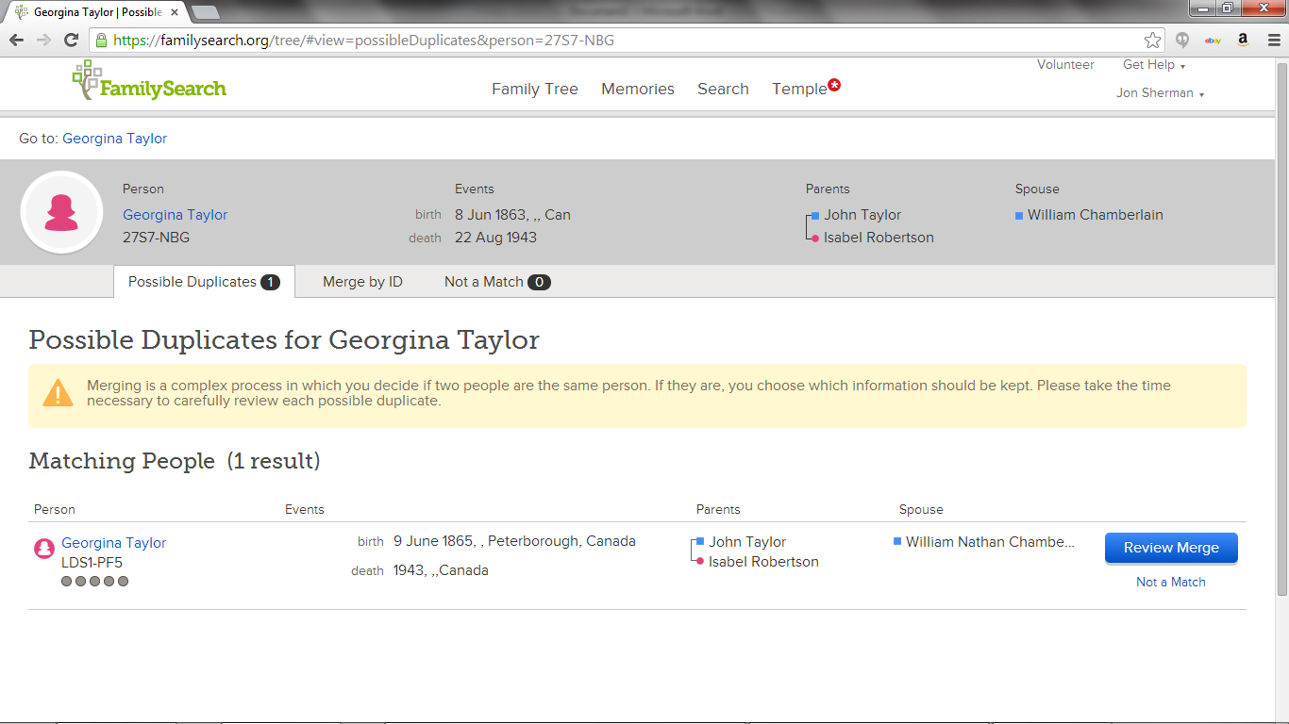
Merging Duplicates
All possible duplicates will be shown with your original record listed on top.

Slide 16
Merging Duplicates
If you can tell that someone on the list is not a match, click on “Not a Match”. This will prevent the name from showing up again and from mistakenly being merged with your ancestor.

Slide 17

Merging Duplicates
To review a possible match in more detail, click on the “Review Merge” Button next to the corresponding name.

Slide 18
Merging Duplicates
On the Merge Screen you will see your original record on the left, and the possible duplicate on the right.
Review all data carefully.

Slide 19
Merging Duplicates
If you decide they are indeed a match, you can select what information to add to your original if it has some data that yours does not. Click on add/replace or reject for each element.

Slide 20
Merging Duplicates
Important: When you are done, the person and the info. on the left will be kept in Family Tree. The info. on the right will be deleted.

Slide 21
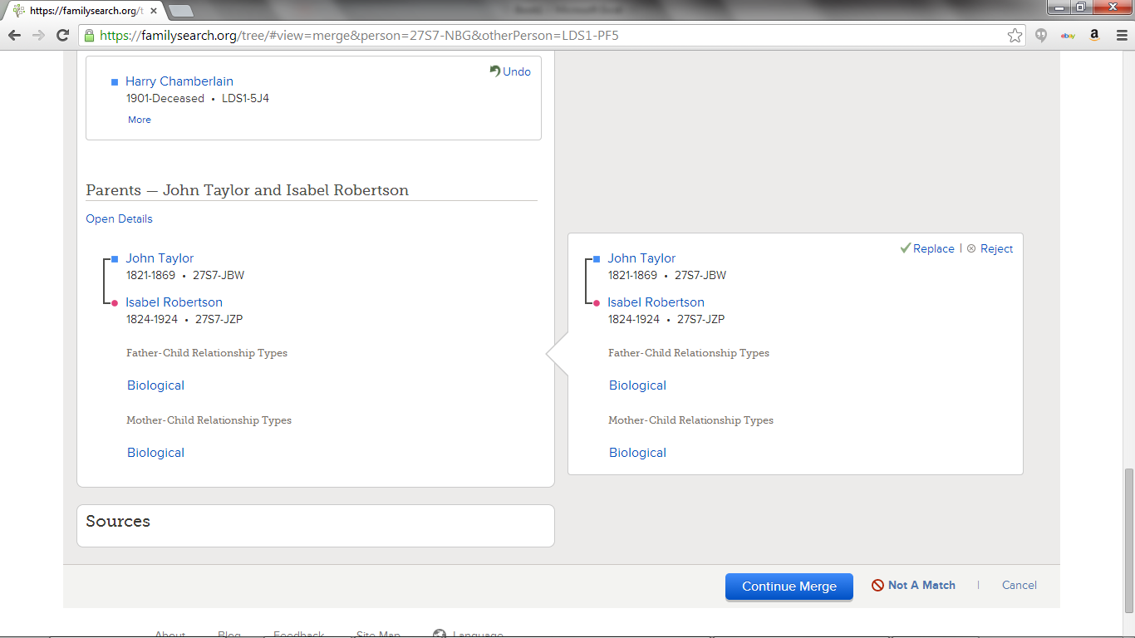
Merging Duplicates
When finished, click on “Continue Merge”. Merges can always be undone. Type a reason for the merge, then you are done.

Slide 22
Editing Vital & Other Information
Now that you have found and attached documentation and merged possible duplicate records, we want to make sure that the Vital and Other information sections are filled-in and contain accurate information.

Slide 23
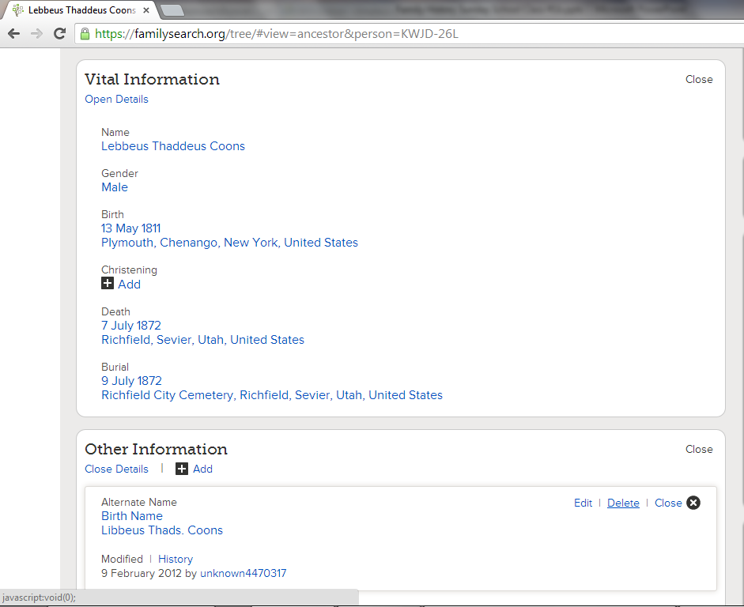
Editing Vital & Other Information
Vital and Other information is editable.
Make sure this information is correct.
Here is how:

Slide 24
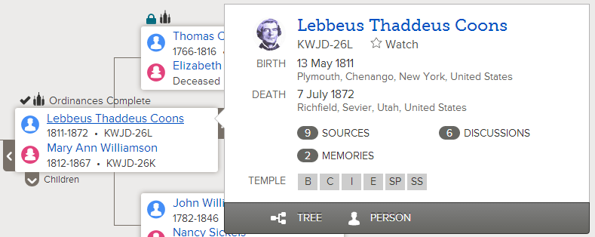
Editing Vital & Other Information
On Tree view, click on your ancestor then person view.

Slide 25
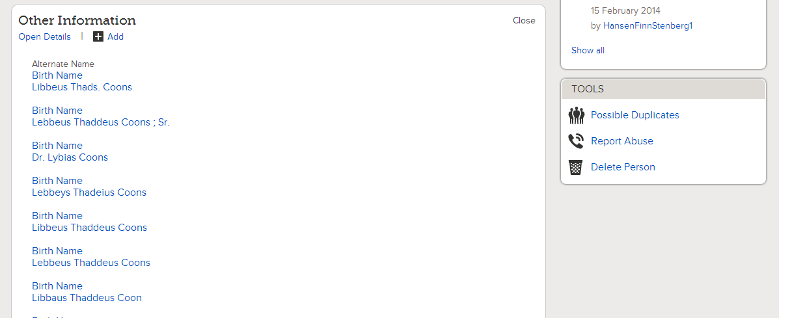
Edit Other Information
Scroll to “Other Information”.

Slide 26
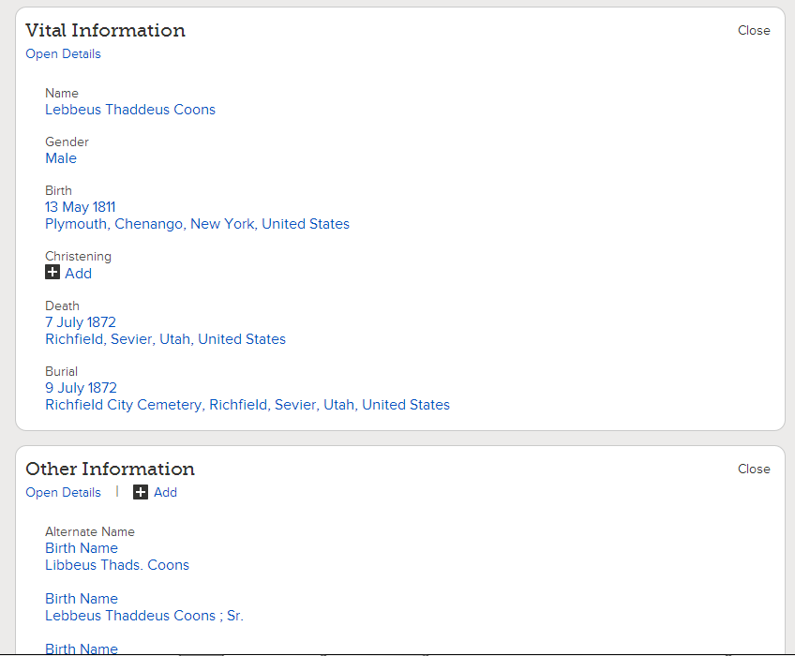
Edit Other Information
Compare Vital Info. to documentation to make sure they match.
Exceptions should be mentioned under notes.
Delete incorrect entries under “Other Information”.

Slide 27
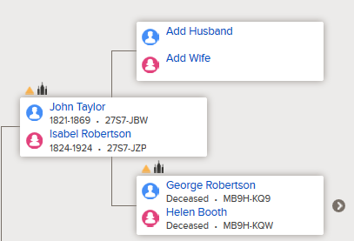
Establish Relationships
With documentation added to your ancestor and vital information filled-in and correct. Search for parents of your ancestor.
Documentation may
provide you needed
clues to find them.

Slide 28
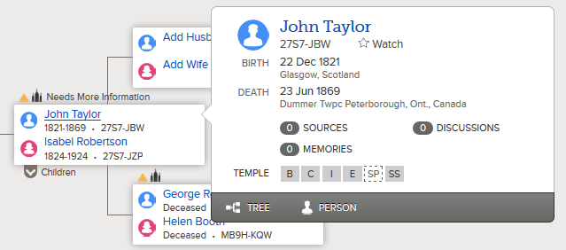
Establish Relationships
To add a parent, go to Tree View, and click on your ancestor.
Click on
Person view.

Slide 29
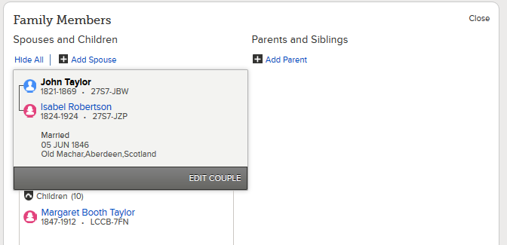
Establish Relationships
Scroll down to “Family Members” and click on “Add Parent”.

Slide 30
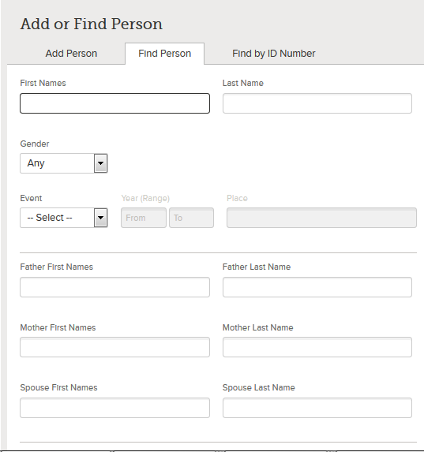
Establish Relationships
You have 3 Options:
  Add Person
  Find Person
  Find By ID Number

Slide 31
Establish Relationships
Find Person: allows you to enter search parameters, names and dates and look for existing records (People already entered into FamilySearch).

Slide 32
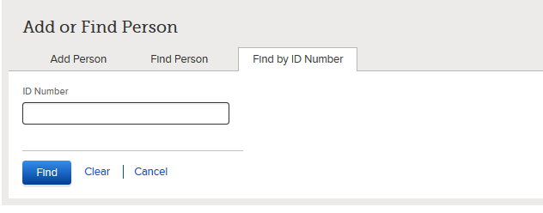
Establish Relationships
Find By ID Number: allows you to enter an already known Person ID Number for your ancestor’s parent. This only applies if you have searched for and found this number in
the past.
Perhaps you compared
3 and settled on one
you think is best.

Slide 33
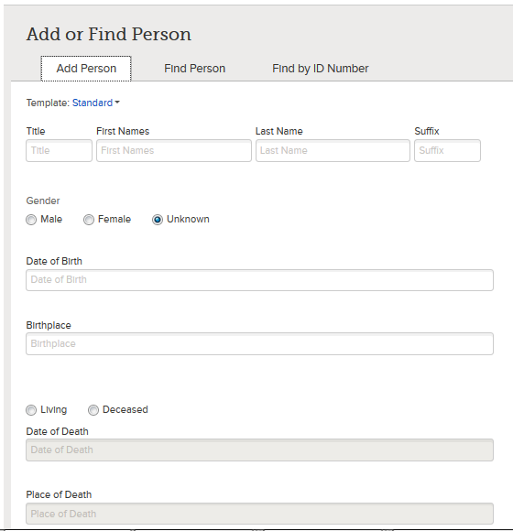
Establish Relationships
Add Person: If no FamilySearch record exists for your ancestor’s parent, you may have to create it.
This is done by filling out the Add Person tab.

Slide 34
Hands-On!
Login to familysearch.org.
Go to an ancestor. Click on Possible Duplicates and look at some records side-by-side to compare.
Look at “Other information”, See any errors?

Slide 35
Homework:
Keep searching for documentation for your ancestors and attaching them to their records.
If you have any that have all three sources of vital documentation, look for
possible duplicates.
Next Class: Printing Family Ordinance
Requests. [FORs]

