Slide 1


Family History
Lesson #2
Documents, Photos and Stories

Slide 2

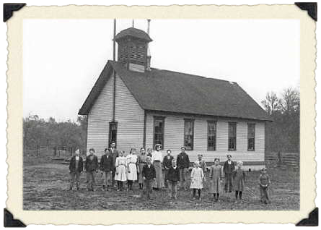
Review Last Week’s Homework
Go to Createfan.com
  Print 4 & 9 Generation Fan Charts and Pedigrees.
Go to iwillprepare.com > Family History
  Print and read Family History Guide
  Print Checklist & Research Log.
  Fill out names on checklist from Pedigree.
Assemble your Binder

Slide 3
What is Documentation?
Documentation or sources are records used to identify your ancestors.
Documentation of key life events such as Birth, Marriage and Death are considered “Vital Documentation”.
Other records such as census records, family histories, deeds, etc…, are considered secondary records.
When documentation is attached to your ancestor’s record, you can be sure you have identified the correct person.

Slide 4
Documentation. Why is it important?
Documents and sources provide positive identification.
There are many Walter Shermans, but only one born in Hardy County, WV. on March 27, 1881 who later married Bertha Septema Coons on April 8, 1908 at Tombstone Arizona and who died at Pomerene, Arizona on May 2, 1934.
Good sources will assure accurate merging of records. You will be far less likely to merge the record of one Walter Sherman with another of the same name (but unrelated).

Slide 5
Documentation. Why is it important?
The prevention of repeated temple ordinances is a second major goal of family history. By precisely identifying our ancestors we will prevent well-meaning members from doing ordinance work over and over again.
Good sources and documents form the basis for family history. In finding the historical references of our ancestors lives, we get to know them and are able to understand them and empathize with them. From this understanding we can develop a biographical sketch to pass on to future generations.

Slide 6
Types of Source Documents
Vital Records: Records of key life events, namely, Birth, Marriage and Death.
Primary Records: Recount an event at or close to the time it happened; original records of events and may include: diaries, journals, state or federal census records, courthouse records such as deeds, will probates, birth or death records, baptism or marriage records. Also included as primary sources would be ship's passenger lists and military records.

Slide 7
Types of Source Documents
Secondary Records: Published records, including: family histories, indexes or compilations of census or marriage records, any sort of history (county, state, etc.), and collections of cemetery inscriptions, for instance.
Primary records are, of course, the most reliable sources, but secondary records can provide you with many clues for further research.

Slide 8

Vital Sources
Find vital sources (or next best) and post them to sources on the ancestor’s Person Page for each individual.

Slide 9
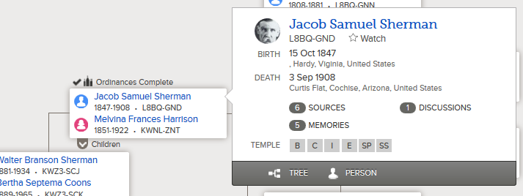

Searching for Documents
Within FamilySearch.org
From Tree View, click on the person’s name whose documents you are looking for.
Click on “Person” to see the “Person Page”.

Slide 10
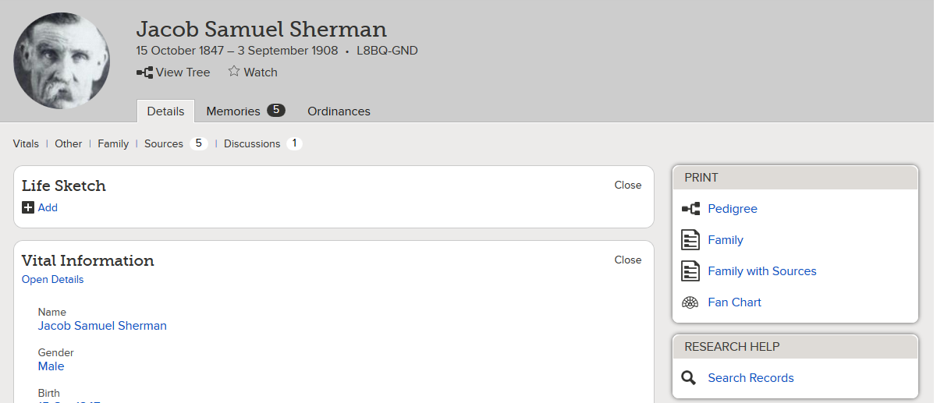
Searching for Documents
Within FamilySearch.org
Click on “Search Records”.

Slide 11
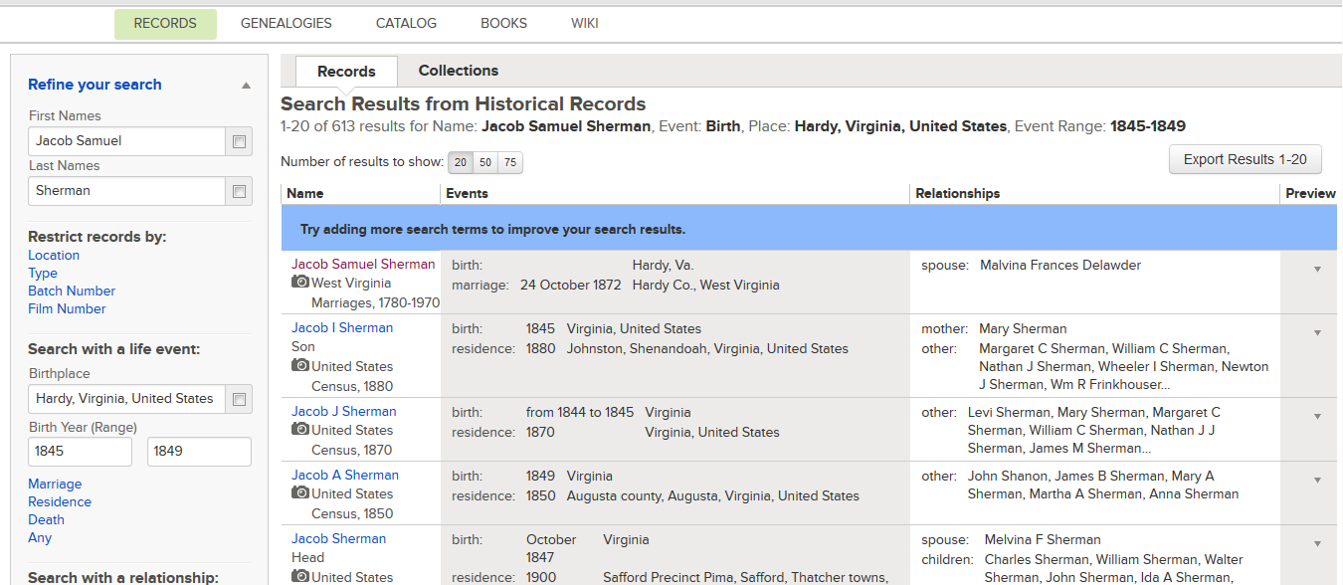
Searching for Documents
Within FamilySearch.org
Click on the desired result or refine your search.

Slide 12
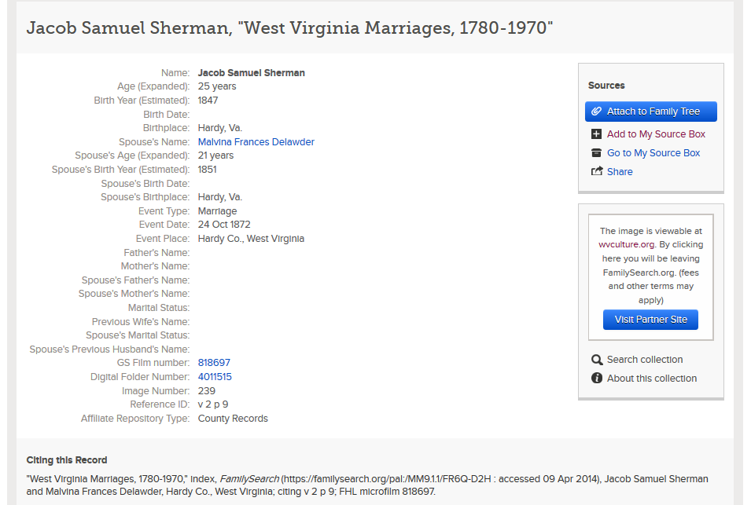
Searching for Documents
Within FamilySearch.org
Here you will see the indexed results.
To view the actual document, click on “View Document” or “View Partner Site” if available.

Slide 13
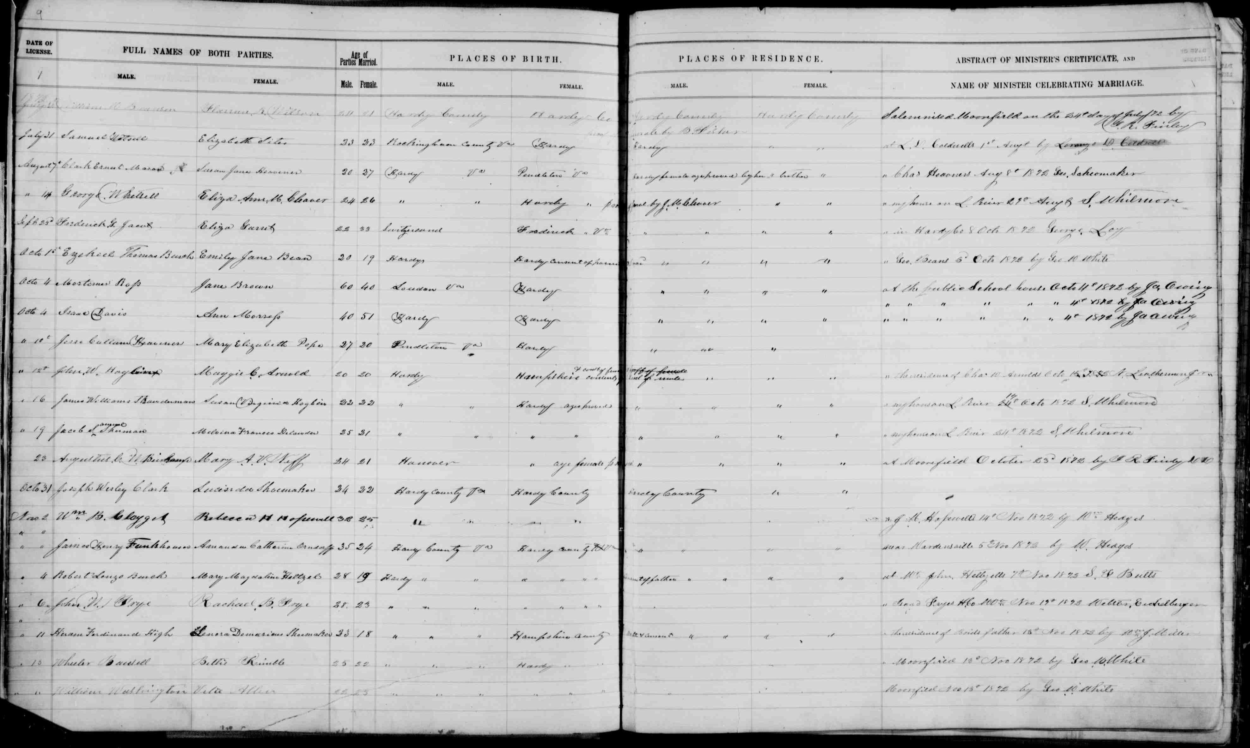
Searching for Documents
Within FamilySearch.org
Image of original document.

Slide 14
Searching for Documents
Within FamilySearch.org
Click “Attach to Family Tree” to add this document as a “Source” to your ancestor’s record.

Slide 15
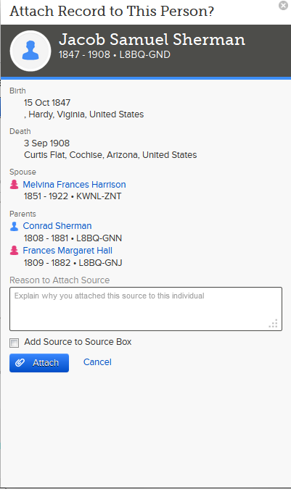
Searching for Documents
Within FamilySearch.org
Confirm you are adding the source to the correct ancestor and then click “Attach”.

Slide 16
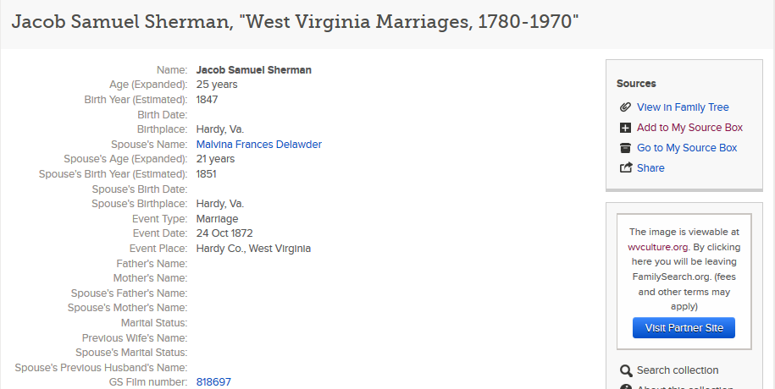
Searching for Documents
Within FamilySearch.org
You can now return to the person page and view your newly added source.

Slide 17
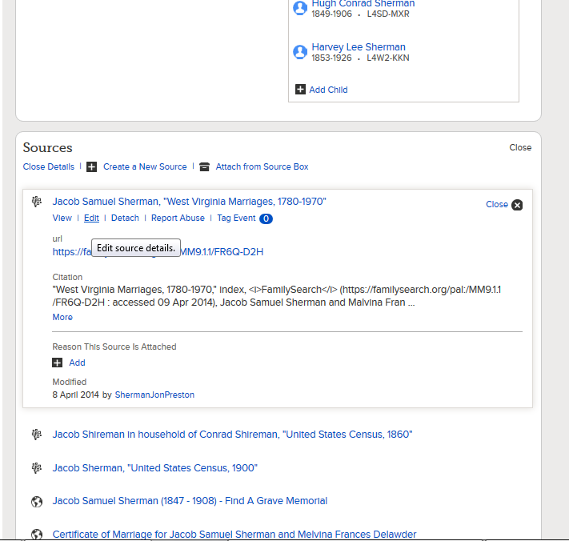
Editing Source Title
Sources are linked to your ancestor using the Indexing project name.
Click the Source and then “Edit” to rename it something more appropriate.

Slide 18
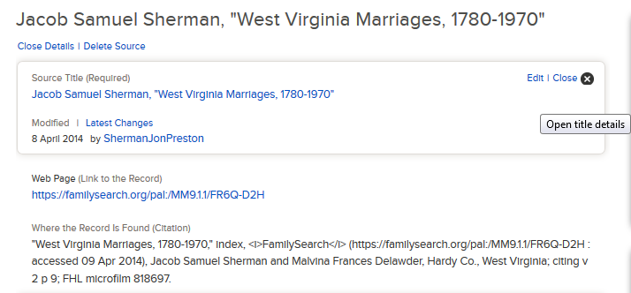
Editing Source Title
In the expanded view, click “Edit” again.

Slide 19
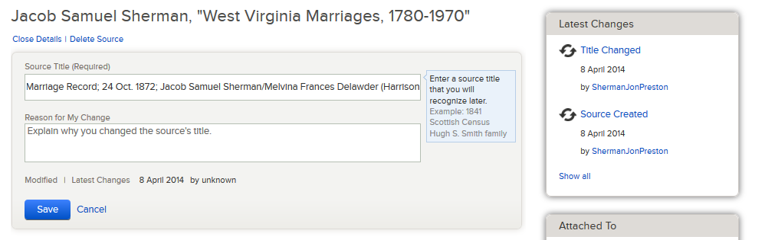

Editing Source Title
Rename the Title to something more appropriate.
Here is one possible naming convention:
  Record Type; Date; Person’s Name
  Birth Record; 10 Oct 1820, John William Jones
  Marriage Record; 15 Aug 1835; James Paul Smith/Bertha Lynn Peterson

Slide 20
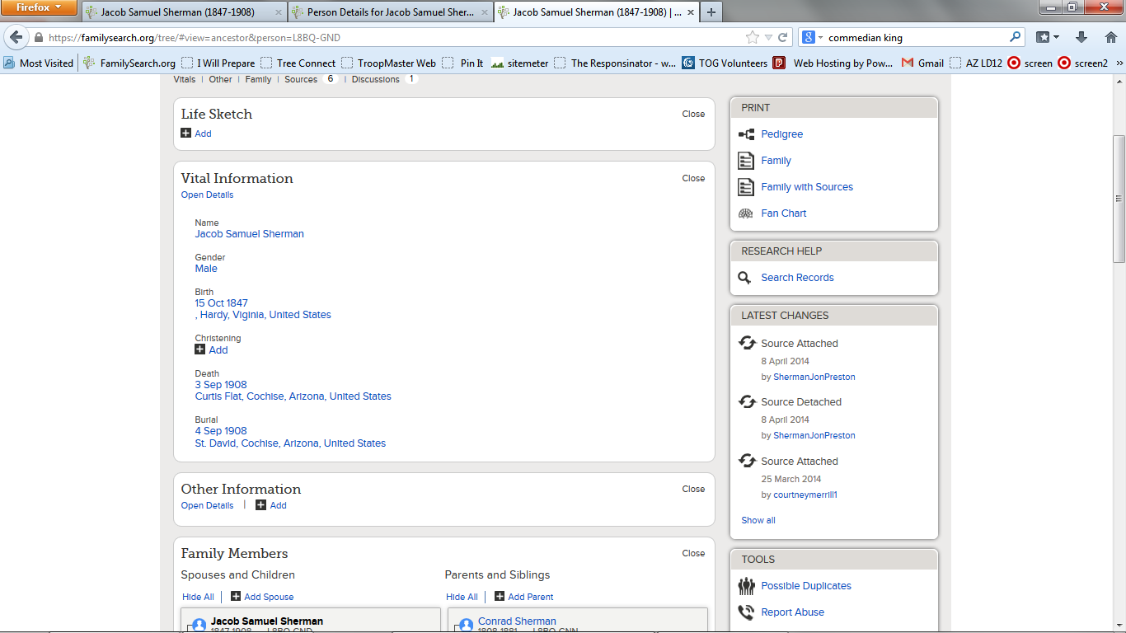
Tag Source Event to Vital Information
You can tag each field under “Vital Information” to a source.
This will validate that the information is correct.
For example, this is the correct birth date, because it is listed on the birth record, death record and headstone.

Slide 21
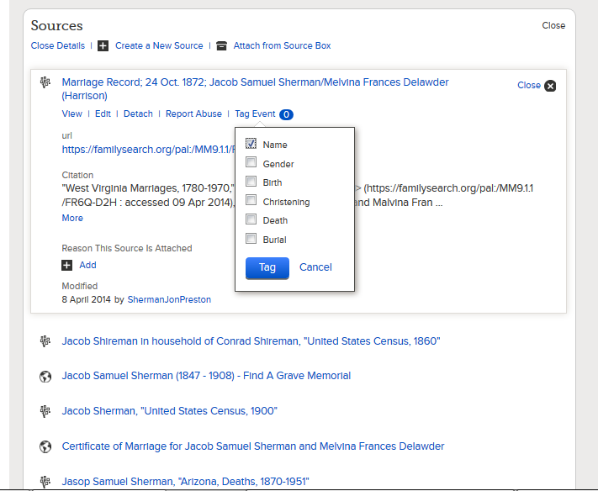
Tag Source Event to Vital Information
On the ancestor’s Person/Details page, click on your newly added source.
Click on “Tag Event”.
Check the data this source contains.
Click the blue “Tag” button.

Slide 22
Tag Source Event to Vital Information
You can also click on the desired field under vital Information…

Slide 23
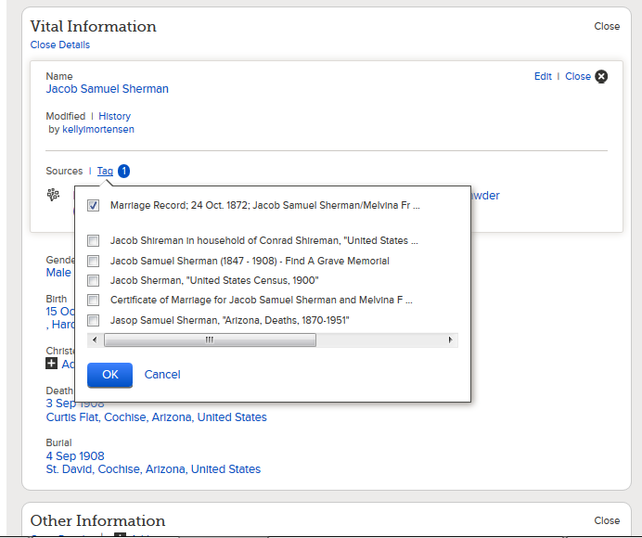
Tag Source Event to Vital Information
…and select the sources that validate this information.

Slide 24
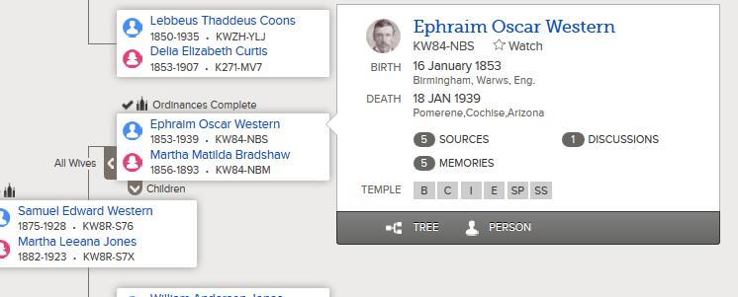
Uploading a Source to FamilySearch.org
If you have a document you have scanned or have on your computer. You can upload it to Family Tree.
In Tree View, click on the desired ancestor and “Person” to go to their person page.

Slide 25
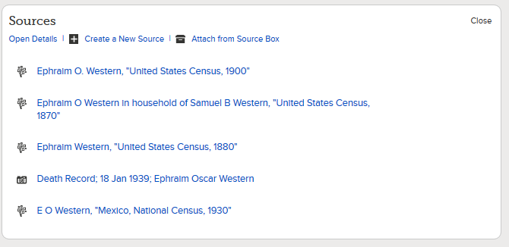
Uploading a Source to FamilySearch.org
Under “Sources” click on “Create New Source”

Slide 26
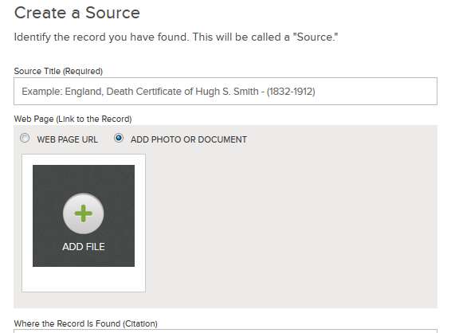
Uploading a Source to FamilySearch.org
Click the “Add File” button to browse for the file on your computer.
To link to a web page, click “Web Page URL” and paste the link.

Slide 27
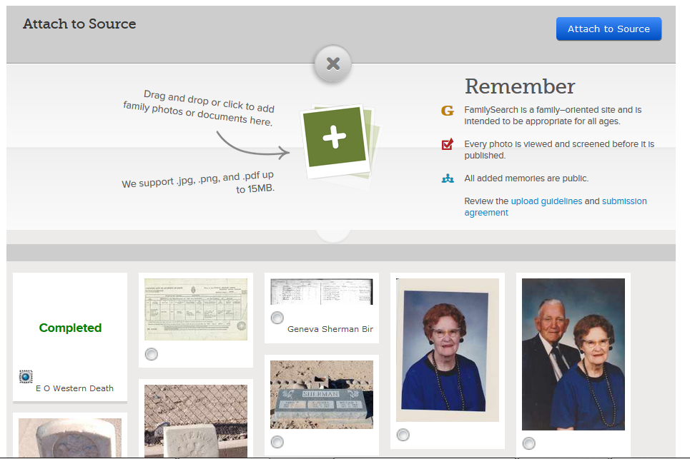
Uploading a Source to FamilySearch.org
If you haven’t already uploaded the document, click on the green plus button.
When the file finishes
uploading, it will be
visible below.
Select the correct file and
click attach to source.
3
1
2

Slide 28
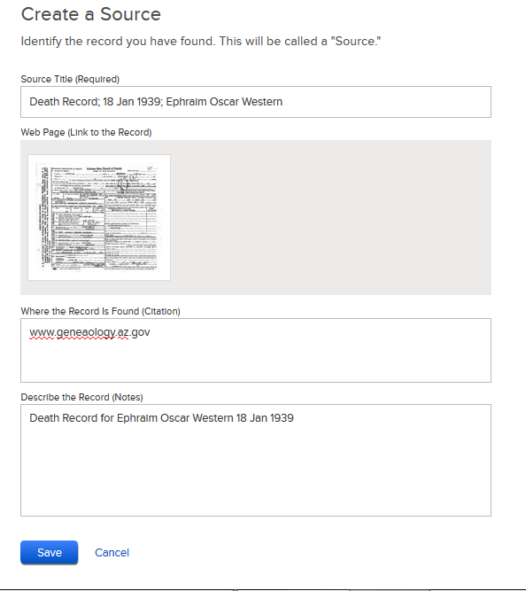
Uploading a Source to FamilySearch.org
Add Source Title, Where the record was found and Record Description.
Click “Save”.
Consider naming conventions.
Tag Source to Vital Information.

Slide 29
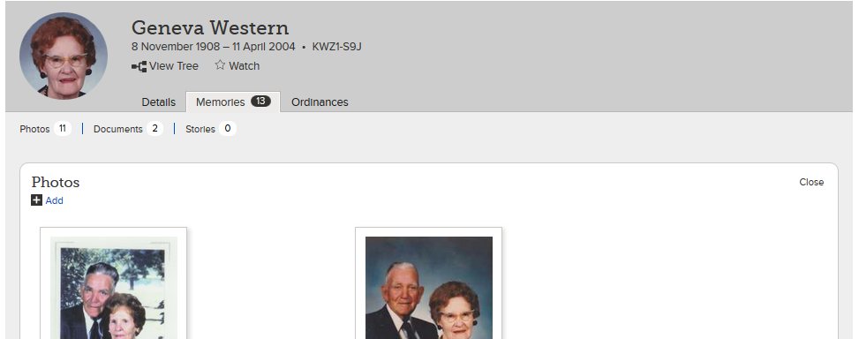
Uploading Photos to FamilySearch.org
Go to your ancestor’s Person View and click on the Memories tab. Under Photos, click on “Add”.

Slide 30
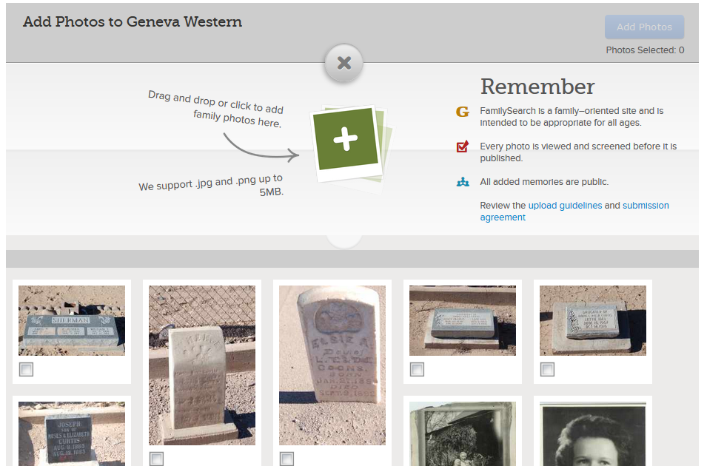
Uploading Photos to FamilySearch.org
If you haven’t already uploaded the document, click on the green plus button.
This will allow you to browse for the file on your computer.

Slide 31
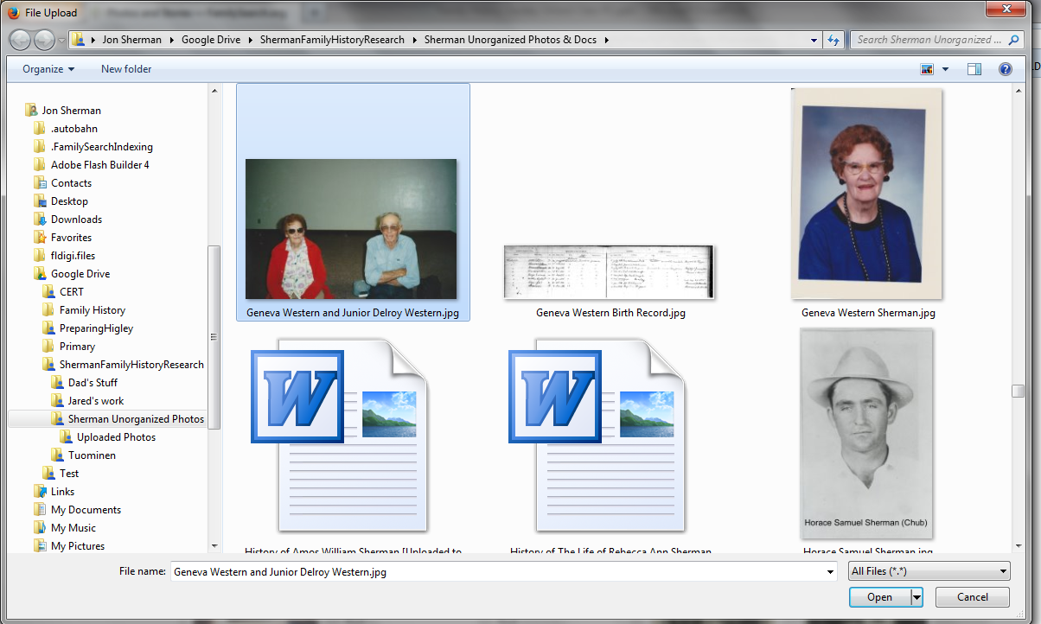
Uploading Photos to FamilySearch.org
In the file upload window, select the photo you want to upload and click “Open”.

Slide 32
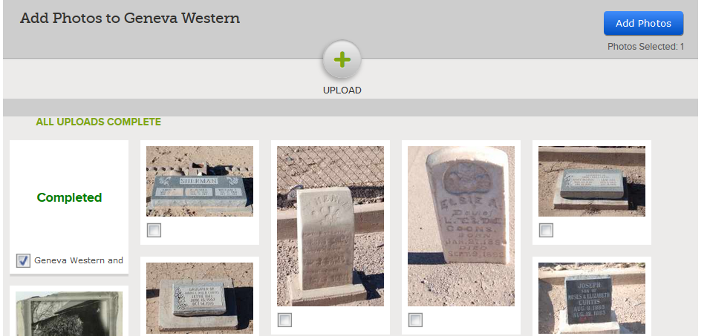
Uploading Photos to FamilySearch.org
When the file finishes uploading, it will be visible below.
Select the correct file and click “Add Photos”.

Slide 33
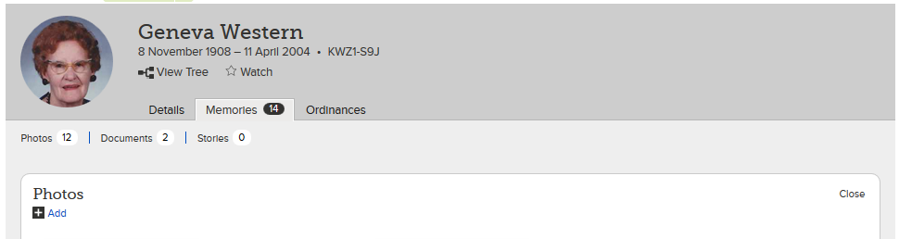
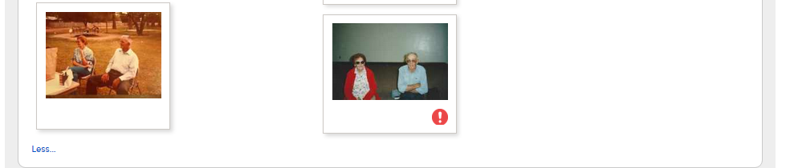
Uploading Photos to FamilySearch.org
Once the file is uploaded, it will be visible under the Photos section.
Next we need to tag
the individuals in the photo.
Click on the red exclamation point under the photo you just uploaded.

Slide 34
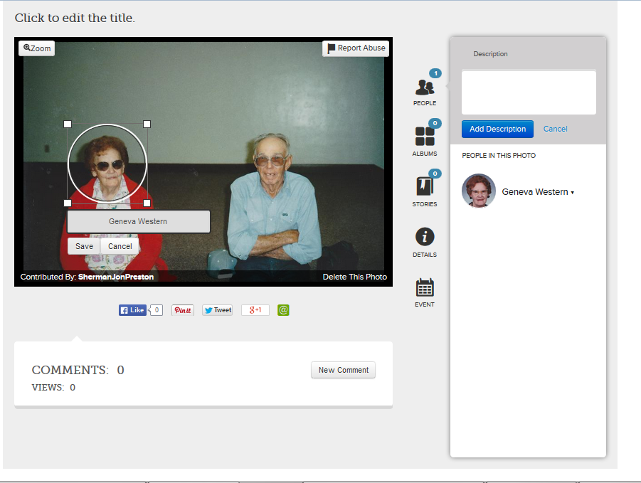
Uploading Photos to FamilySearch.org
On the tag screen, click on the photo and place a circle around the head of the primary subject.
Type their name and click save.
This tags them in the photo.

Slide 35
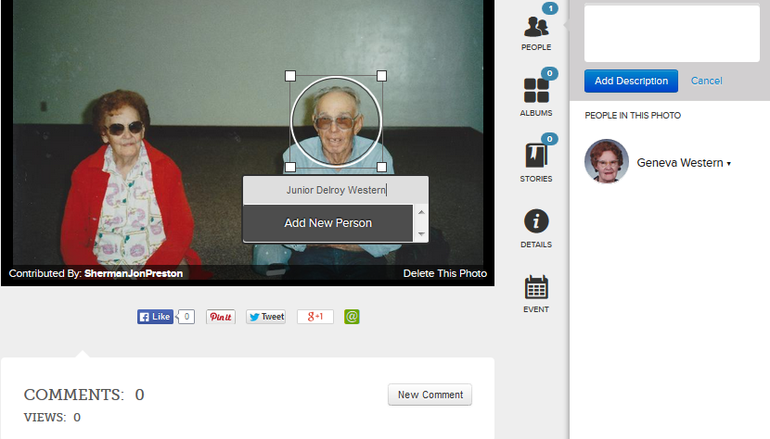
Uploading Photos to FamilySearch.org
Tag other pictured individuals by clicking the picture, creating a circle around their faces, typing their names and then clicking “Add New
Person”.

Slide 36
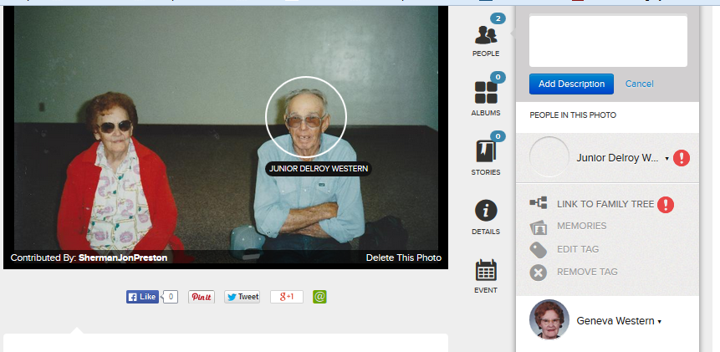
Uploading Photos to FamilySearch.org
These additional individuals will need to be linked back to their record in family tree.
Click the red exclamation point to search for their record.

Slide 37
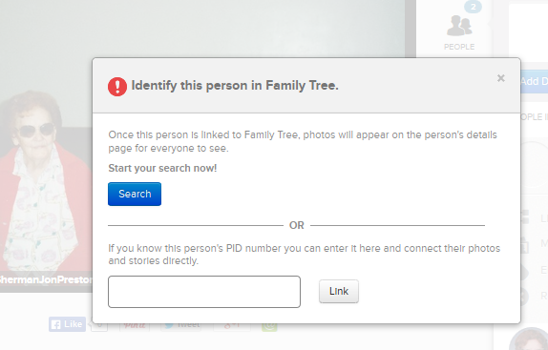
Uploading Photos to FamilySearch.org
You can enter their Person ID if you have it handy, or look for them by name by clicking the blue “Search” button.

Slide 38
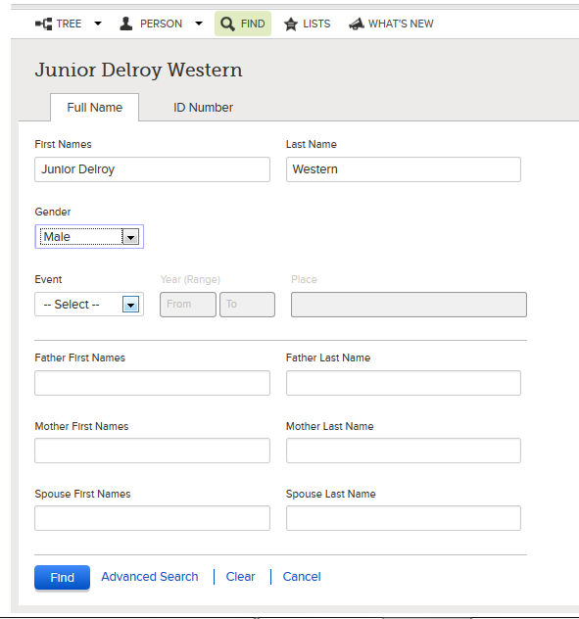
Uploading Photos to FamilySearch.org
Type his/her name and click the blue “Find” button.

Slide 39
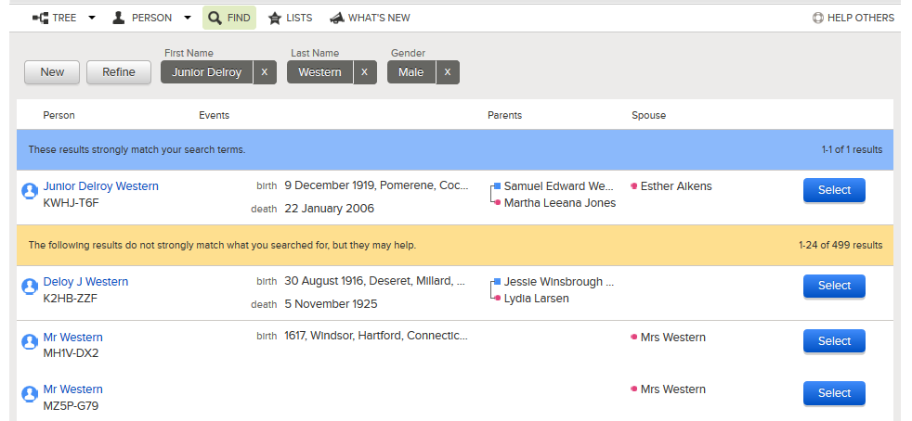

Uploading Photos to FamilySearch.org
Choose the correct person and click on “Select”

Slide 40
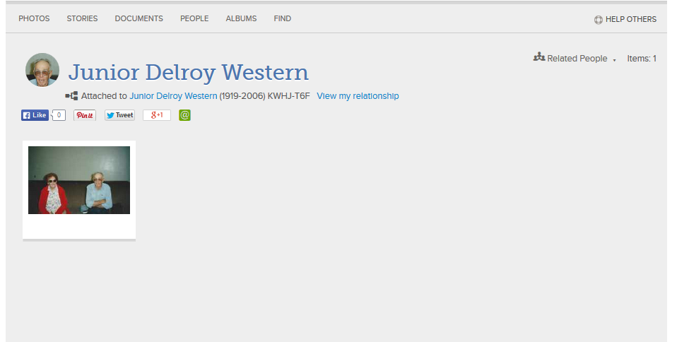
Uploading Photos to FamilySearch.org
Once completed, the photo will be added to each person’s photos.

Slide 41
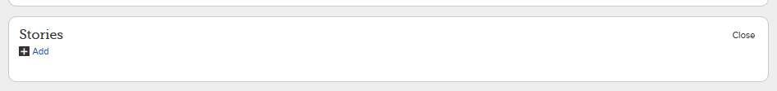
Adding Stories
Go to your ancestor’s person view and click on the “Memories” tab.
Under “Stories”, click on “Add”.

Slide 42
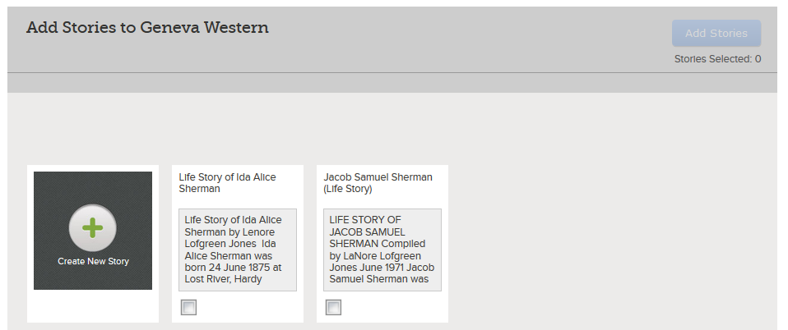
Adding Stories
Click on the “Create New Story” button.

Slide 43
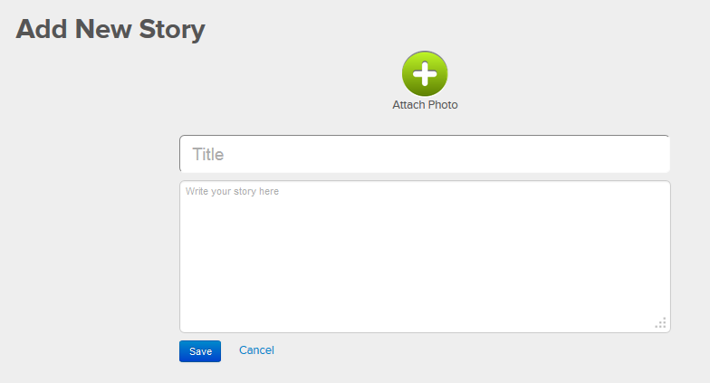
Adding Stories
Type a Title for your story.
Copy and paste or type your story then click “Save”.

Slide 44


Adding Stories
Once the story is added, select it and then click “Add Stories” button.

Slide 45
Hands-On!
Login to familysearch.org.
Go to an ancestor, search records and attach the source to them.
Tag the source event to vital information.
Upload a photo, document or life story.

Slide 46
Homework:
Search for records within FamilySearch.org for several of your ancestors.
Find or scan photos or documents of some of your ancestors.
Upload them to familySearch.org

