Slide 1


Family History
Lesson #1
Family History Intro. & Plan

Slide 2

What is Family History?
Genealogy: Names, life events, places, and dates.
Family History: More comprehensive, including stories, anecdotes, photographs, and other interesting details about our ancestors. It is about getting to know them!
What does Family History mean to us as members of the church?

Slide 3
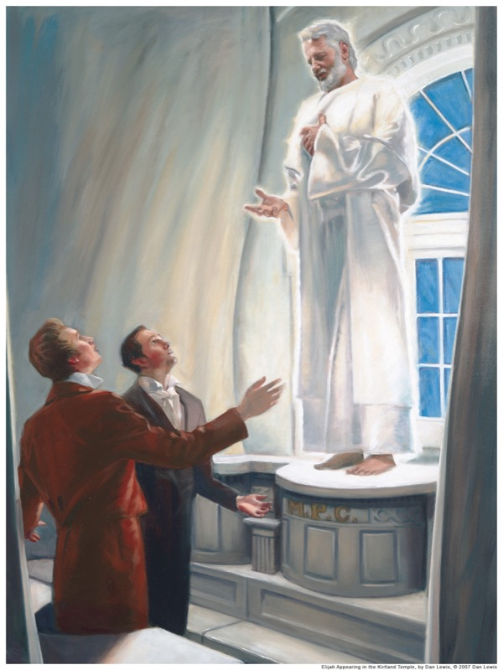
Behold, I will send you Elijah the prophet before the coming of the great and dreadful day of the Lord:
And he shall turn the heart of the fathers to the children, and the heart of the children to their fathers, lest I come and smite the earth with a curse.
(Malachi 4:5-6)

Slide 4
Behold, the great day of the Lord is at hand...Let us, therefore, as a church and a people, and as Latter-day Saints, offer unto the Lord an offering in righteousness; and let us present in his holy temple, when it is finished, a book containing the records of our dead, which shall be worthy of all acceptation.
(D&C 128:24)

Slide 5
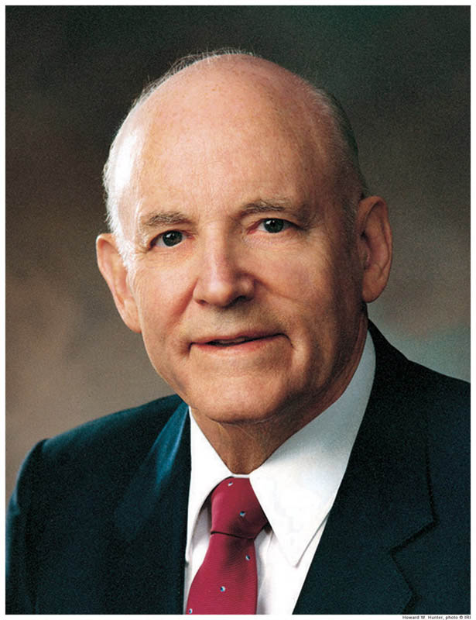
“I have learned that those who engage in family history research and then perform the temple ordinance work for those
whose names they have found will know
the additional joy of receiving both halves of the blessing.”
- Howard W. Hunter, “A Temple-Motivated People,” Ensign, Feb. 1995

Slide 6
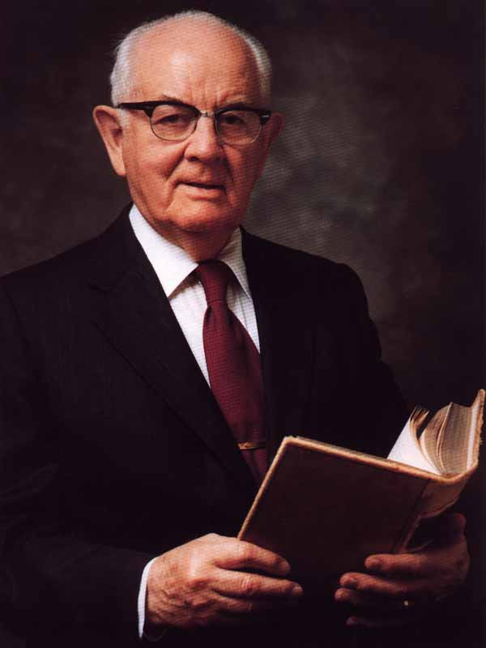
“Thousands of our faithful people seldom go to the temple, and of those who do go, most are not working on their own ancestral lines. They are not saving their own dead. They seem to believe
they are fulfilling their responsibilities by merely attending the temple occasionally. This is simply not so. We all must learn to save our own dead. We must properly identify them so that we can then perform the work for them in the temples …”
- Spencer W. Kimball, Regional Representatives Seminar, Sept. 30, 1976

Slide 7
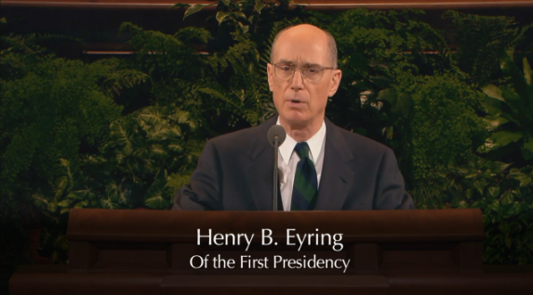

Why Do We Do Temple Work?
Video: 1m 55s
https://www.youtube.com/watch?v=nseEmVaoWq8

Slide 8

Family History Challenges
In the past, our biggest challenge in doing family history and temple work, has been the duplication of effort and ordinances.
New tools have and will continue to be developed to help reduce duplication and improve collaboration.

Slide 9
Family History Challenges
The church has developed a Family History website, FamilySearch.org, where we can both search for records and organize our research.
Building on these new innovations, and to simplify your efforts, the Gilbert Higley Stake has developed a process to help you with your family history experiences.

Slide 10

Success Through Organization
With Family History, like all large projects, it is best to be organized and break the project into small, manageable tasks.
This can be accomplished be creating
a simple checklist and by stepping
through the tasks listed on it.

Slide 11
Success Through Organization
Being organized will allow you to:
See frequent successes.
Always know what you are working on & what you need to do next.
Have small tasks that you can accomplish even when you don’t have much time to invest.
Delegate tasks to other family members without duplicating work.
Pick up right where you left off, even if it has been months or years since you last got to work on Family History.

Slide 12

Lets
Get Organized!

Slide 13
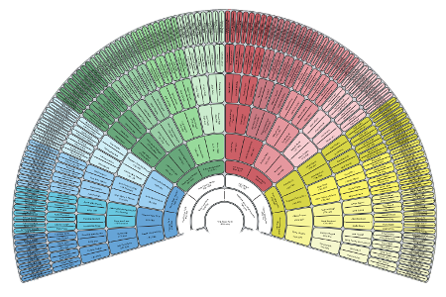
Print Pedigree and Fan Charts
Go to Createfan.com
Login using your FamilySearch.org Credentials
Print a 4 and 9 Generation
Fan Chart.

Slide 14
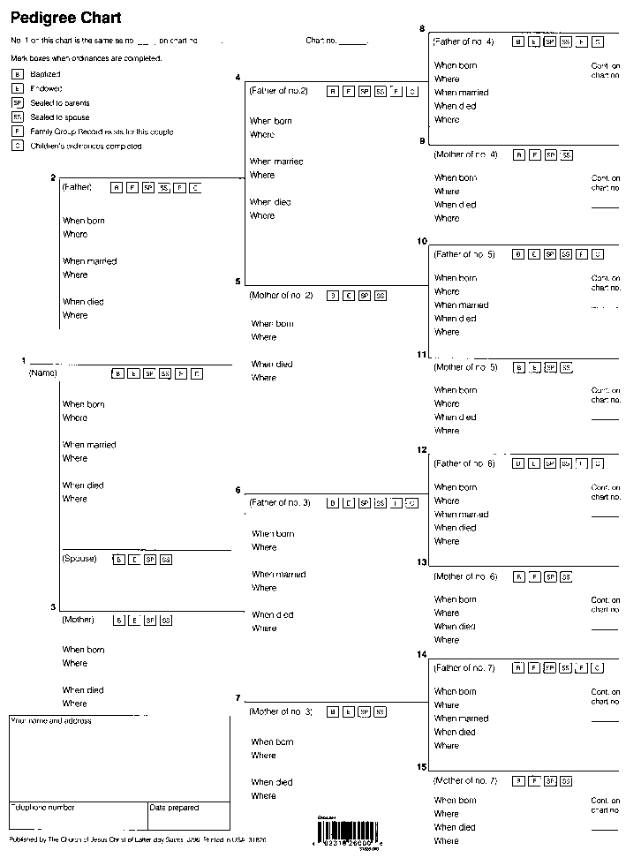
Print Pedigree and Fan Charts
While still at Createfan.com…
Print a 4 and 9 Generation
Pedigree Chart

Slide 15
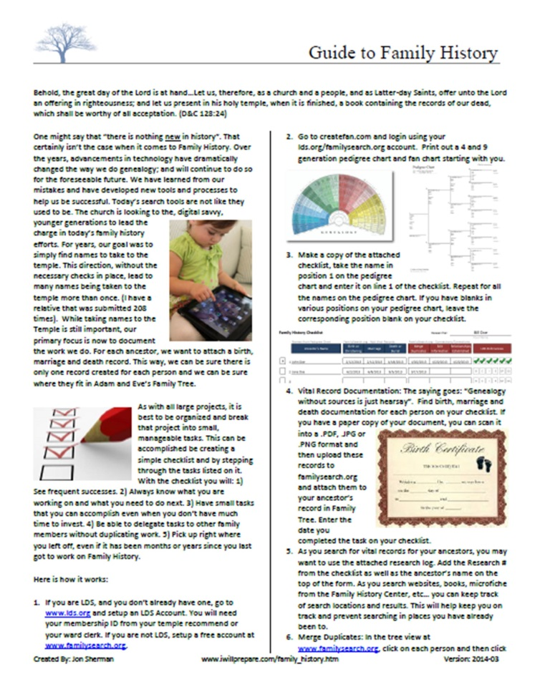
Family History Guide
Go to iwillprepare.com and
click on “Family History”.
Print and Read the 2 page
Family History Guide.

Slide 16
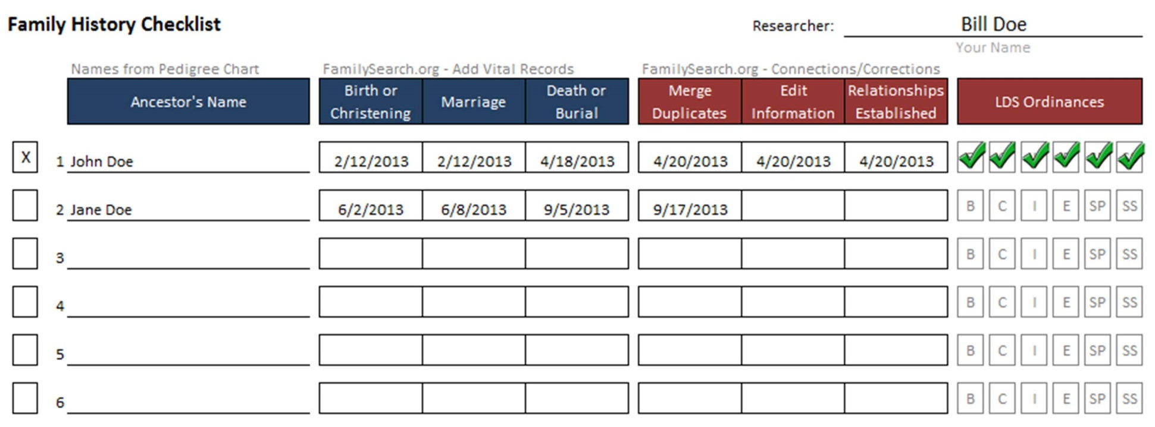
Family History Checklist
Print the Family History Checklist.

Slide 17
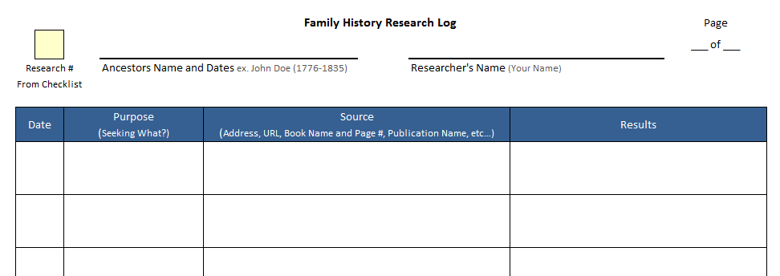
Family History Research Log
Print the Family History Research Log.

Slide 18

Family History Checklist
Take the name in position #1 on the pedigree chart and write it on line #1 on the Checklist.
Continue for all names

Slide 19
Family History Checklist
The checklist will guide you in what work needs to be completed for each ancestor…so you know the work is done.
When you are done with each task, mark the date in the corresponding box. Once all are done, place an “X” to the left of the name.
The checklist allows you to share work with others.

Slide 20
Family History Research Log
Keep track of the research you do by filling out a research log for each ancestor (Some may need multiple pages).
The log keeps track of what you are looking for, where you are looking and the results.
The log helps you remember where you looked so you don’t repeat it later and waste time.

Slide 21
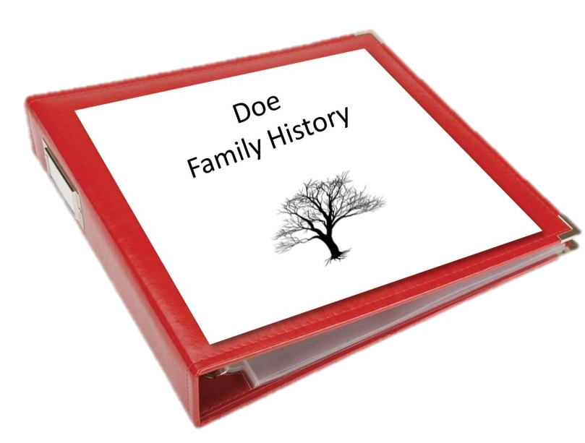
Create a Binder
Place your Checklist, Pedigree Charts, Fan Charts, Research Logs and Family History Guide into a 3-ring binder.
This will keep you organized.
Some may prefer a digital copy
on a flash drive.

Slide 22
What is Documentation?
Documentation or sources are records used to identify your ancestors.
Documentation of key life events such as Birth, Marriage and Death are considered “Vital Documentation”.
Other records such as census records, family histories, deeds, etc…, are considered secondary records.
When documentation is attached to your ancestor’s record, you can be sure you have identified the correct person.

Slide 23
Documentation. Why is it important?
Documents and sources provide positive identification.
There are many Walter Shermans, but only one born in Hardy County, WV. on March 27, 1881 who later married Bertha Septema Coons on April 8, 1908 at Tombstone Arizona and who died at Pomerene, Arizona on May 2, 1934.
Good sources will assure accurate merging of records. You will be far less likely to merge the record of one Walter Sherman with another of the same name (but unrelated).

Slide 24
Documentation. Why is it important?
The prevention of repeated temple ordinances is a second major goal of family history. By precisely identifying our ancestors we will prevent well-meaning members from doing ordinance work over and over again.
Good sources and documents form the basis for family history. In finding the historical references of our ancestors lives, we get to know them and are able to understand them and empathize with them. From this understanding we can develop a biographical sketch to pass on to future generations.

Slide 25
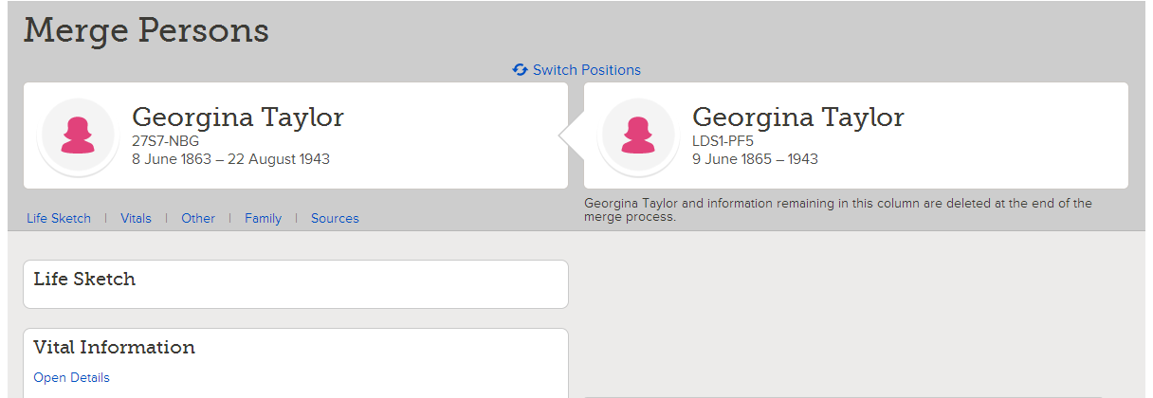
Merging Duplicates

Slide 26
Merging Duplicates
It is not uncommon for multiple records to be created for the same person.
Temple ordinances can often be done many times for an ancestor because multiple records exist.
Merging duplicate records before printing a Family Ordinance Request (FOR) and taking the name to the temple is important to avoid ordinance duplication.

Slide 27
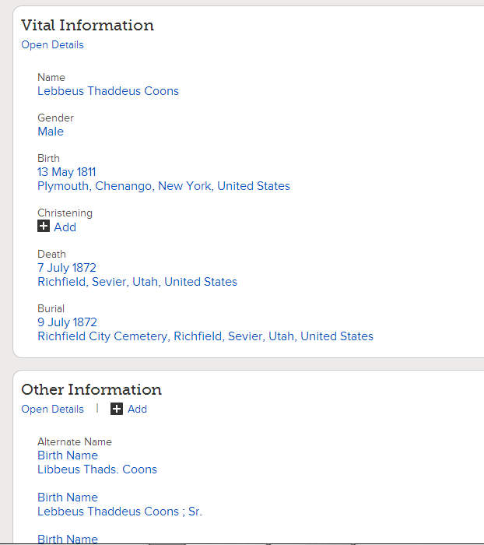

Edit Other Information
Other Information can be created manually or through the importation of data from older databases.
Make sure the data is correct and delete or change incorrect information.

Slide 28
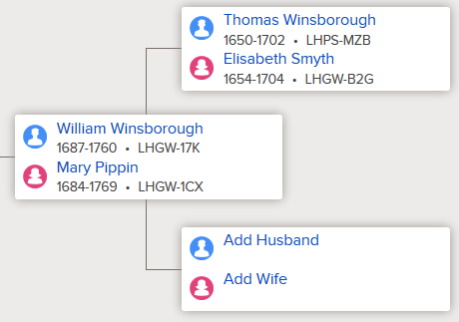

Establish Relationships
With the documentation you have found for your ancestor, you might have the names of his/her parents or some great clues to help
you find them.
If so add them to your
family tree.

Slide 29
LDS Ordinances
Once you have found & added vital documents to your ancestor’s record, merged duplicate records, edited other info, and established relationships, you are ready to print a Family Ordinance Request (FOR) & take the name to the temple.
By now, you probably know a lot about this relative which will make your temple experience more special.
You can feel confident that the research is done right, the ordinances are being done for the first time and will not be duplicated.

Slide 30
Hands-On!
Login and explore familysearch.org.
Practice the basic navigation of the site
  Family Tree
  Person View
  Memories
  Ordinances

Slide 31
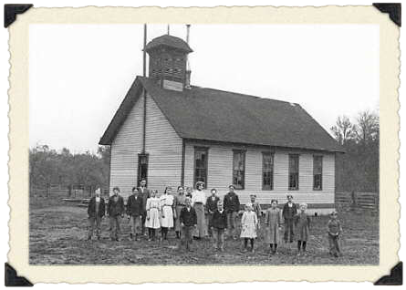
Homework:
Go to Createfan.com
  Print 4 & 9 Generation Fan Charts and Pedigrees.
Go to iwillprepare.com > Family History
  Print and read Family History Guide
  Print Checklist & Research Log.
  Fill out names on checklist from Pedigree.
Assemble your Binder

