Slide 1
Urban Gardening
W. Ralph Pew
Ralph.pew@azbar.org

Slide 2
Reasons for a Grow Box Garden
An Element of Preparedness & Self Sufficiency
Poor Soil
Limited Space
Sun Exposure Changes
Limited Time
Limited Mobility
No Weeding
Easy to Water
Organic
Potting Mix Reuse
Great Hobby/Therapy

Slide 3
STEPS TO SUCCESS
Planting: Seeds/Seedling Plants
Fertilizer: Slow Release Organic
Water: Hand vs. Automated Timer System
Mosquito Control: Biological Mosquito Dunks
Support/Staking System: Fiberglass Rods with Elastic Rope or Nylon Trellis Net
6. Harvest: Typically Young/Tender

Slide 4
USE ONLY POTTING MIX
Peat Moss
Vermiculite
Sand
Perlite
Small Wood Chips

Slide 5
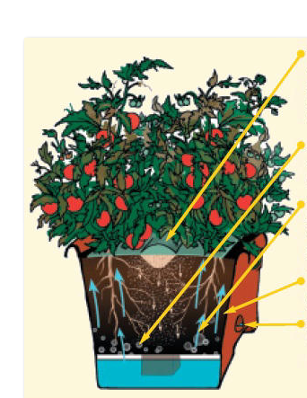
Slow Release Organic Fertilizer
Air enters the soil from the top and bottom to prevent
fungus, root-rot and disease.
Water constantly moves upwards to the roots through
capillary action.
Use simple potting mix for quality results.
Easy to check and refill water level.

Slide 6

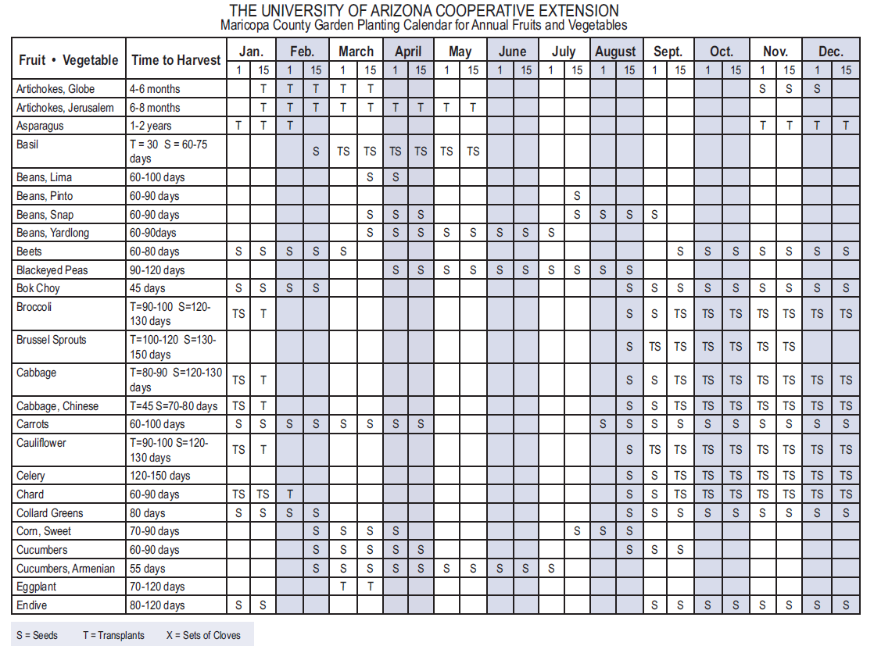

Slide 7
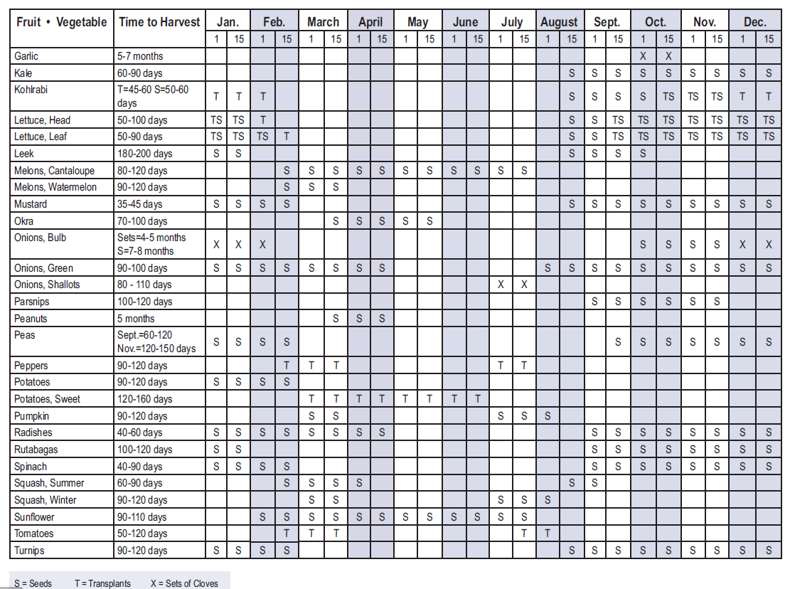

Slide 8
Good Luck & Happy Urban Gardening!
For more information on Urban Gardening, please visit www.agardenpatch.com

